Slide 1

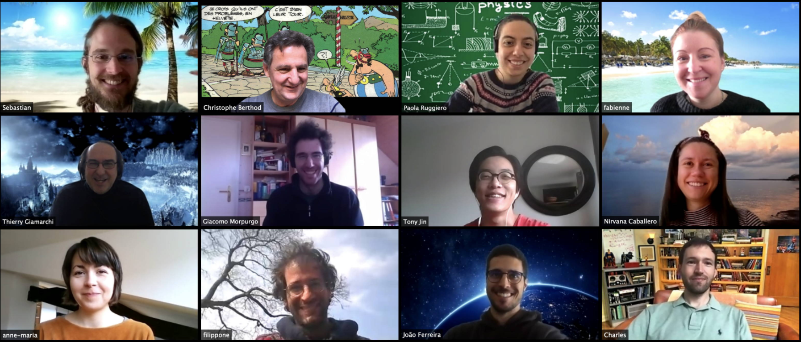
http://dqmp.unige.ch/giamarchi/

Slide 2

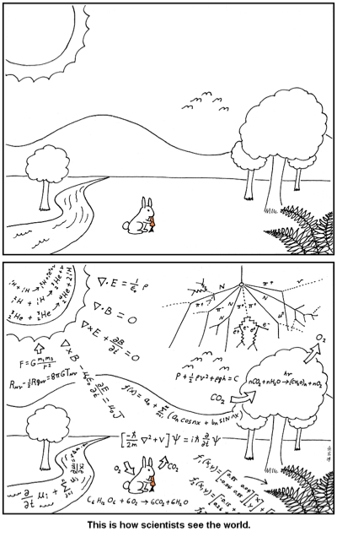
Theorist working on quantum systems
What are we doing ??

Slide 3
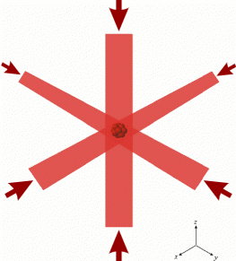
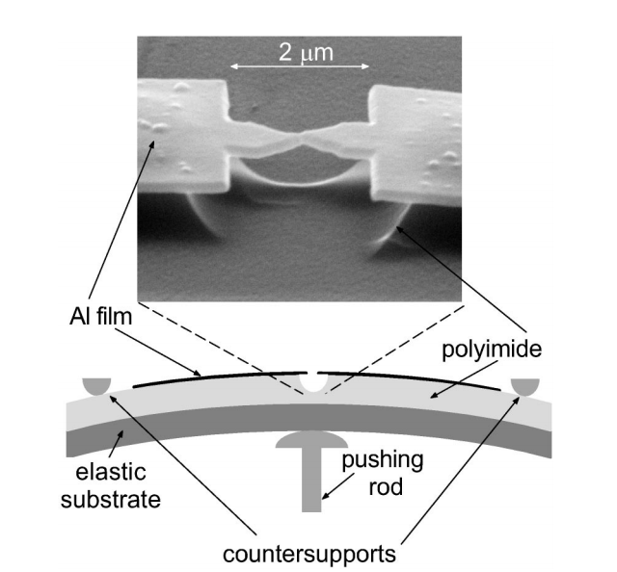
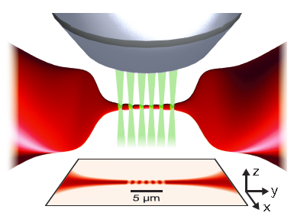
Materials and cold atoms
E. Scheer et al. PRL 78 3535 (1997)
M. Lebrat, P. Grisins et al., PRX 8 011053 (18)

Slide 4
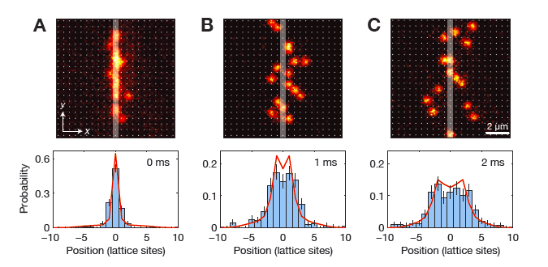
Mobile impurity
T. Fukuhara, et al. , Nat. Phys. (2013)

Slide 5
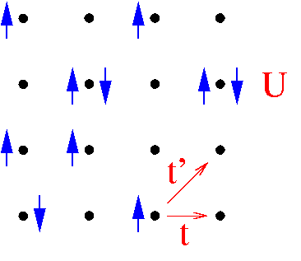

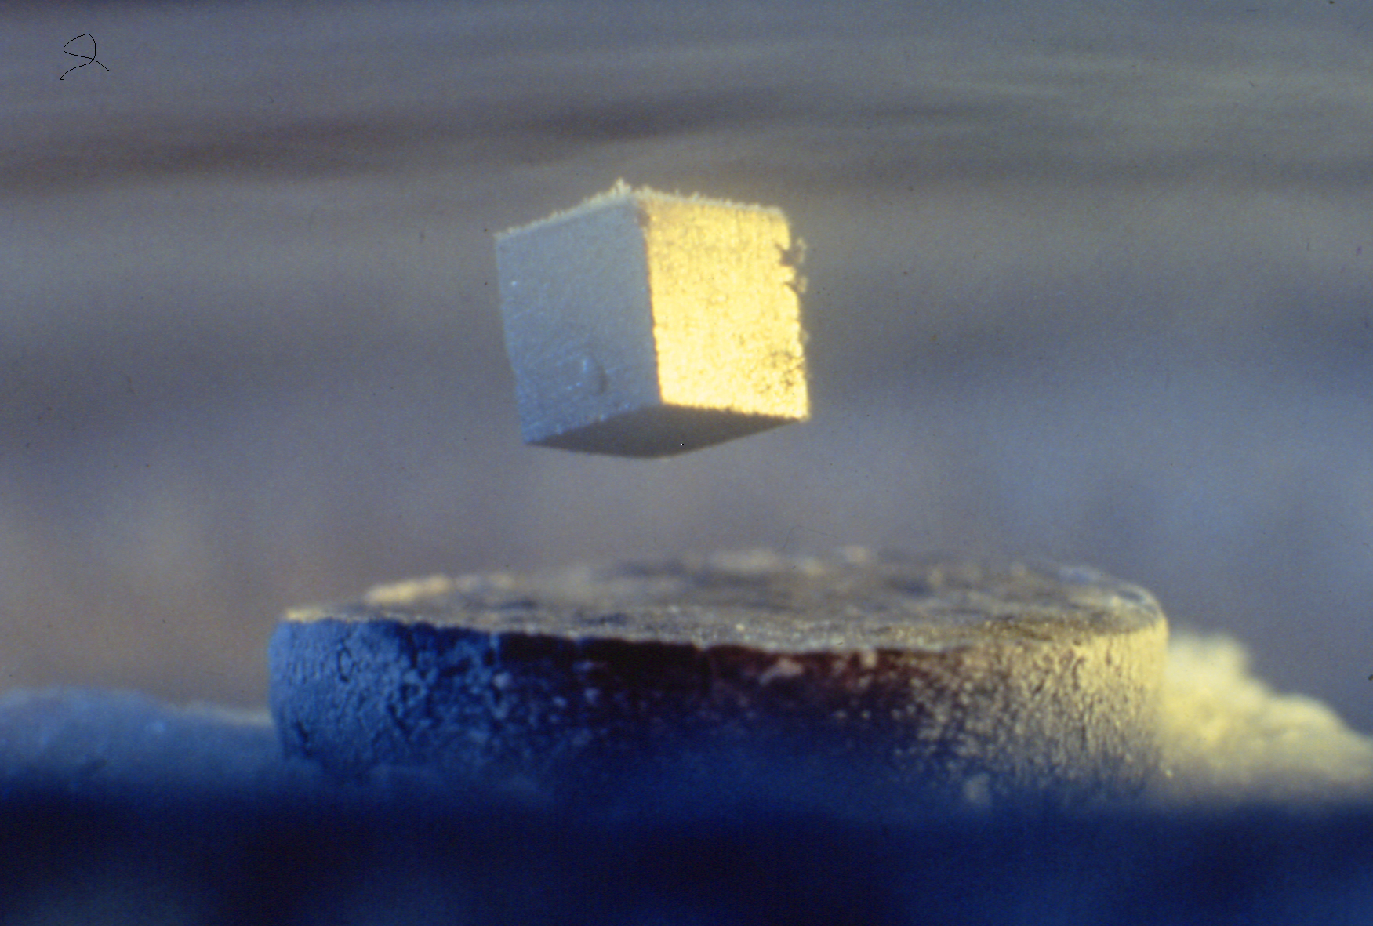
Hubbard model (1963)

Slide 6
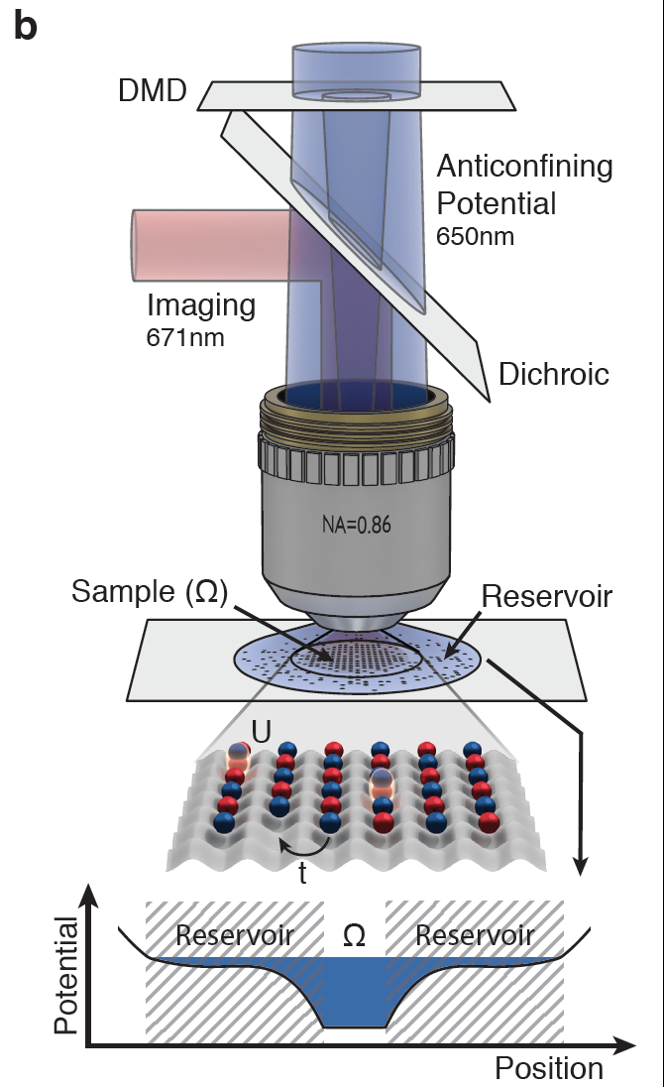
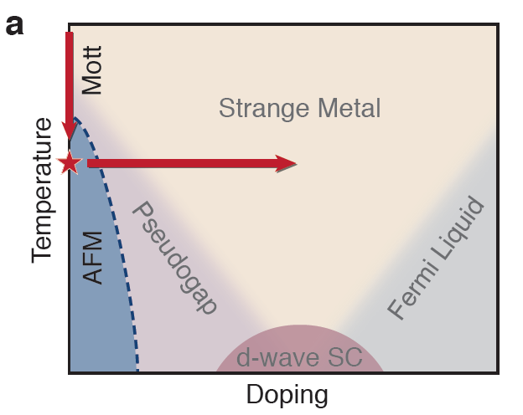
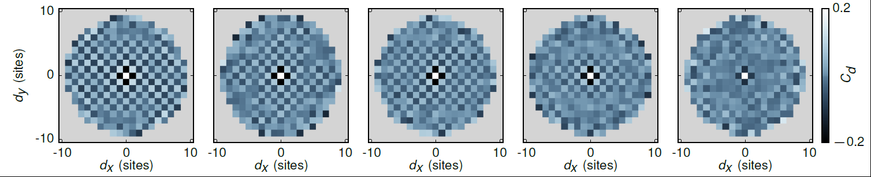
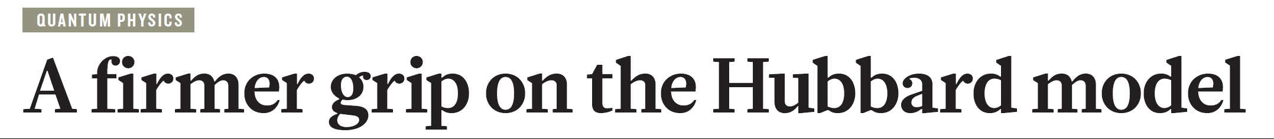
Mazurenko, A. et al. Nature 545, 462–466 (2017).
TG Nature 545, 414–415 (2017).

Slide 7
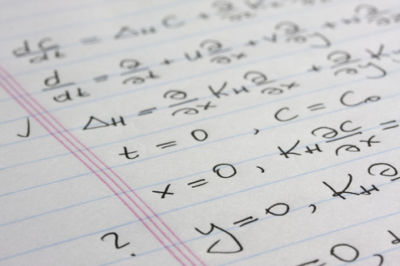
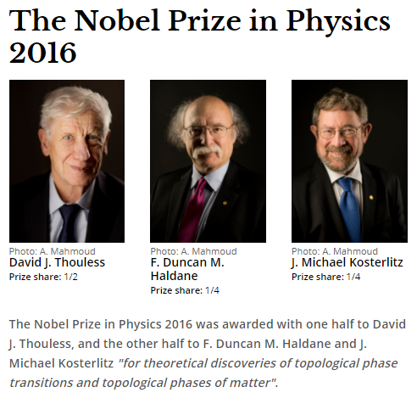
Analytics
Analytic methods: Field theory, Bosonization, Keldysh technique, Renormalization group, Topology……

Slide 8
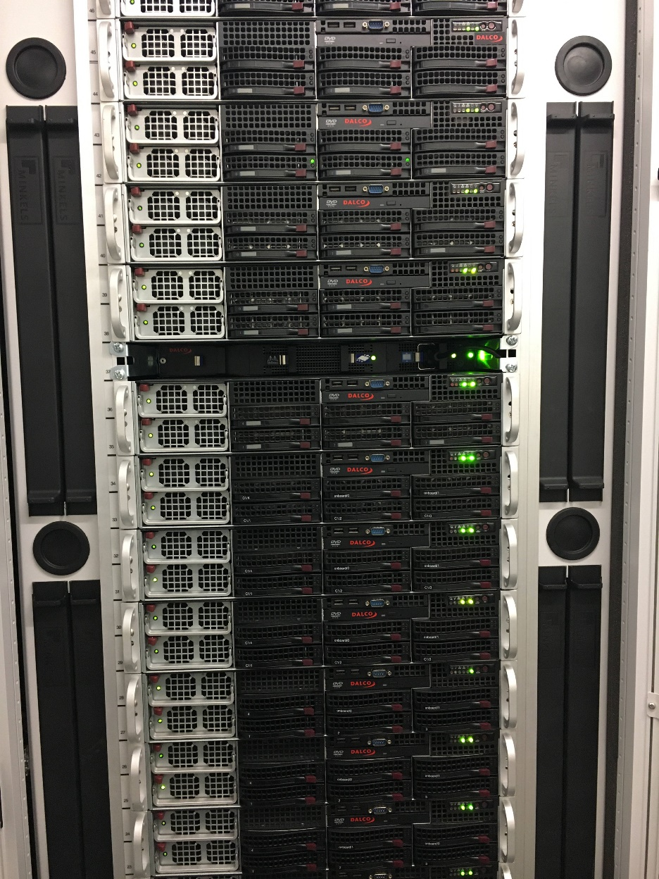
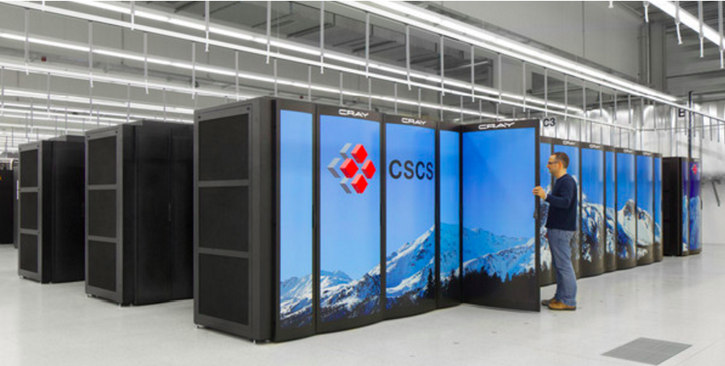
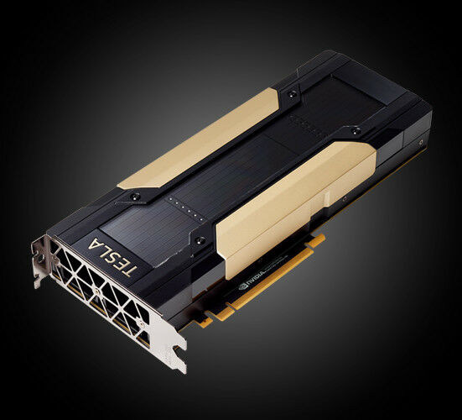
Numerics
CPUs : 1052 coeurs, Intel & AMD, jusqu'à 64 coeurs par machine
CPUs les plus récents : Intel Xeon Gold 6226R, AMD EPYC 7742
GPus : 3 nVidia Tesla V100
RAM : 6.3 Tb total, jusqu'à 384 Gb par machine
Disque : 158 Tb total
Puissance électrique : 16 kW maximum
Valeur : CHF 370'000
Machine la plus ancienne : 2010
Swiss supercomputing center (Mano); machines with 7 10^15 operations per second

Slide 9
To explore further
Peut-on toucher la mécanique quantique
https://www.youtube.com/watch?v=yGI-0MEzoT0
Introduction to ulracold fermions
https://www.youtube.com/watch?v=hplDq7Pn-TE
Much more advanced: Quantum physics in 1D
https://www.youtube.com/watch?v=h1tyqwZ6S_A&t=3s
For fun: Card tricks and quantum mechanics
https://www.youtube.com/watch?v=WLKnh_oDQxo&t=1999s

